Slide 1
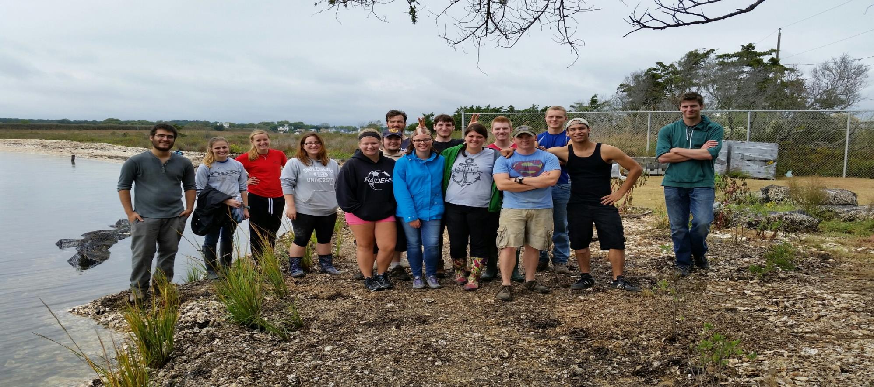
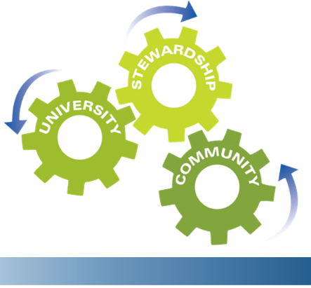
Cultivating Sustainability through General Education Coursework, Professional Development, and High-Impact Co-Curricular Programming and Career Development

Slide 2
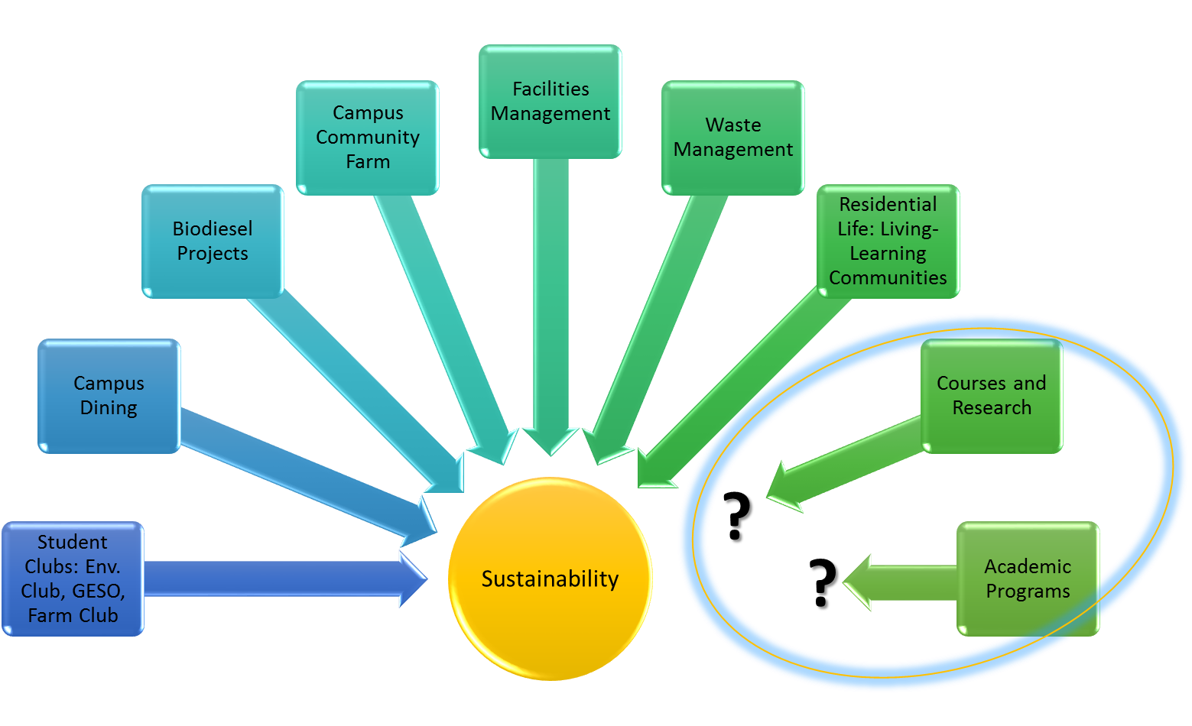
Improving Sustainability at Shippensburg?
Goals
https://www.ship.edu/Sustainability/
Expand professional development related to sustainability for faculty, staff, &administrators;
Increase participation in sustainability/Earth literacy instruction;
Purposefully integrate co-curricular activities to promote student engagement & career development.

Slide 3
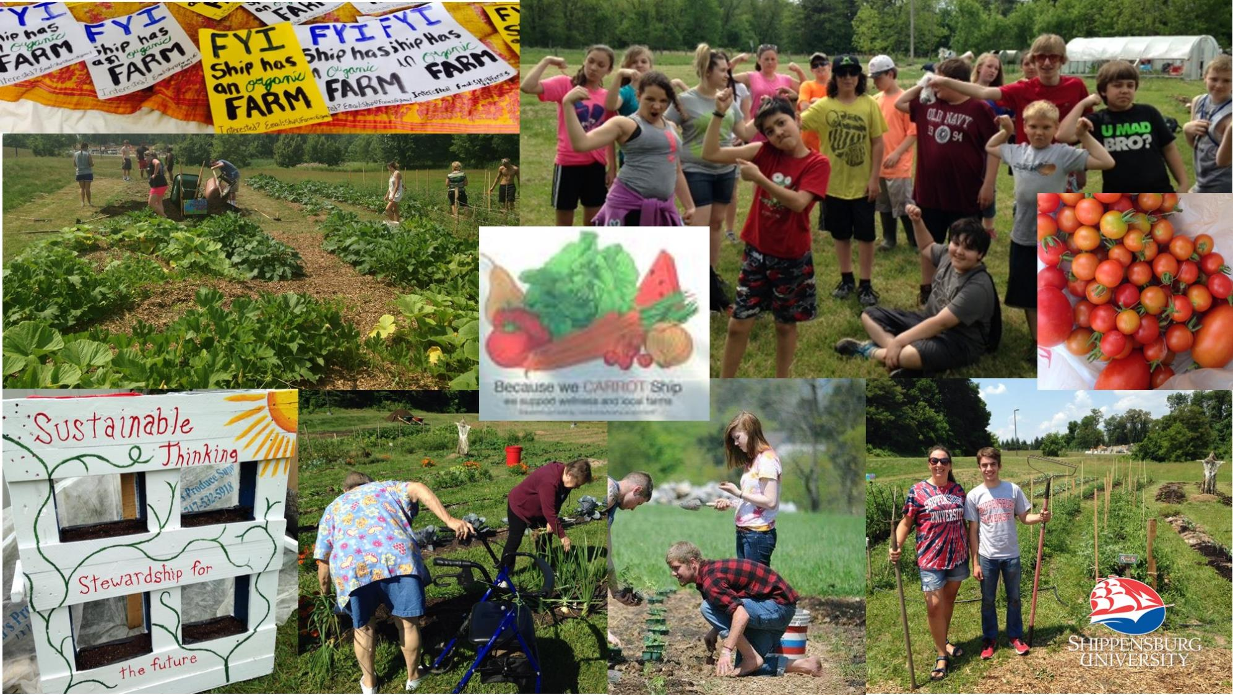

Slide 4
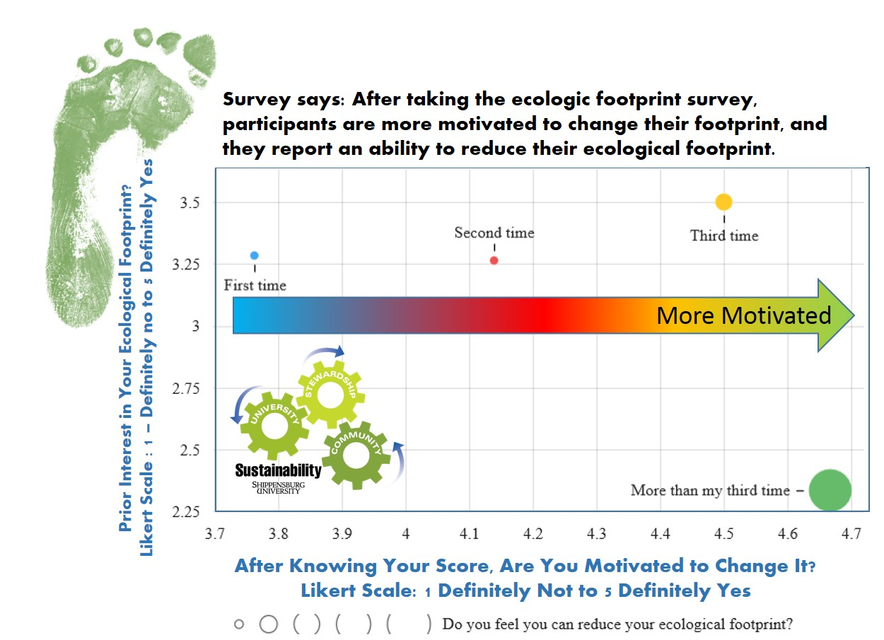
>300 respondents

Slide 6
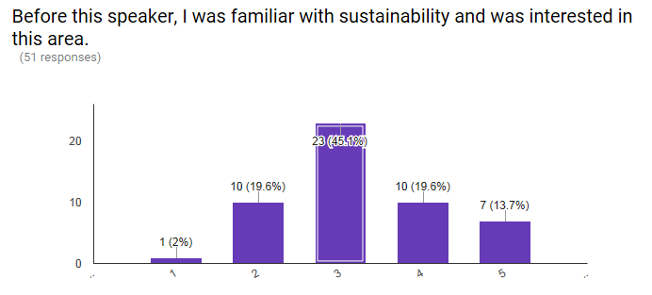
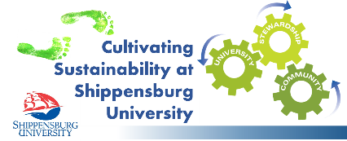
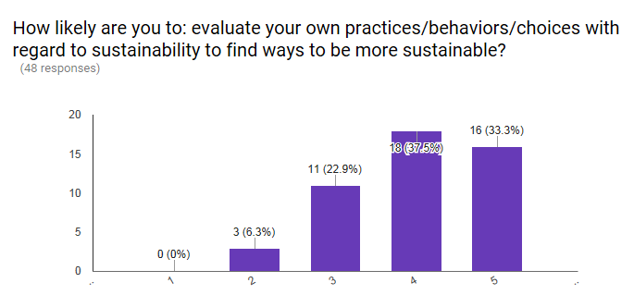
Co-Curricular Programs – Do they inspire/motivate students to think more sustainably?
34% of students Agreed or Strongly Agreed that they were interested/familiar with Sustainability
BEFORE PROGRAMS
71.4% responded with Agree or Strongly Agree
AFTER PROGRAMS
Strongly Disagree
Strongly Agree

