Slide 1
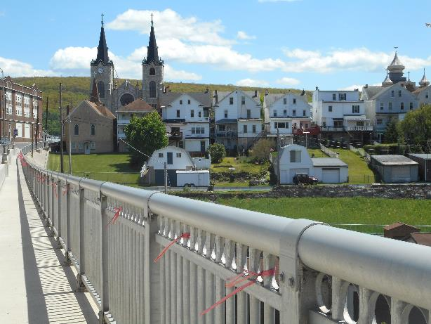
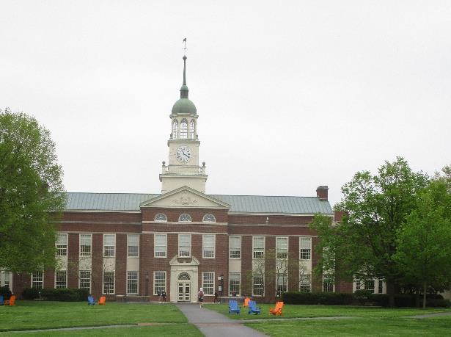
Community-University Partnerships Sustaining the momentum; sustaining our community
Coal Region Field Station

Slide 2
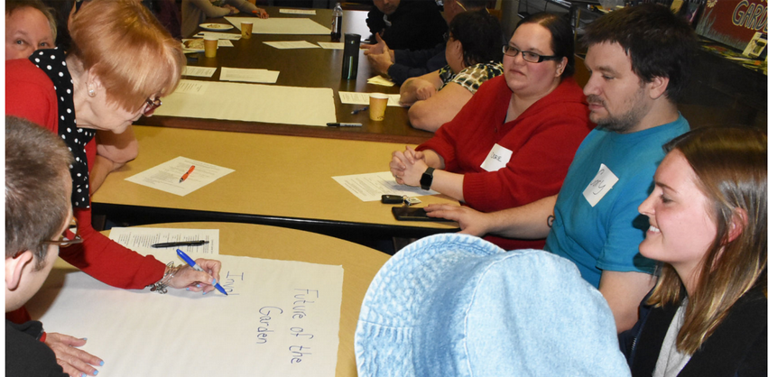
Coal Region Field Station: Mission
This evolving university-community collaboration engages Bucknell students, faculty, and staff with communities in the anthracite coal region by linking together and building upon collaborative projects in community-identified needs for revitalization, explorations of local histories and heritage, and envisioning future possibilities in the common goal of developing sustainable communities.

Slide 3
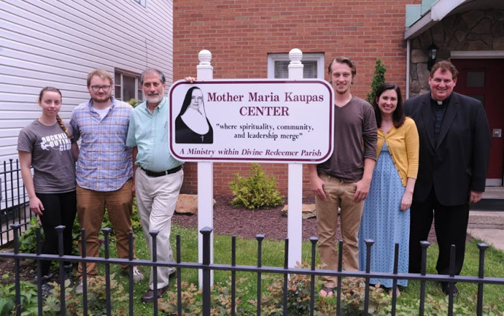
Coal Region Field Station: Vision
By engaging in collaborative, real-world projects addressing community-identified needs, students will become engaged and responsible leaders who respect and value the knowledge and experience of diverse groups, while partner organizations are empowered to enact their visions for thriving, prosperous communities.

Slide 4
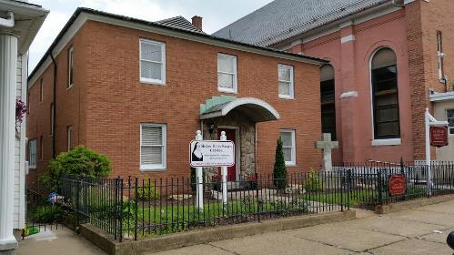
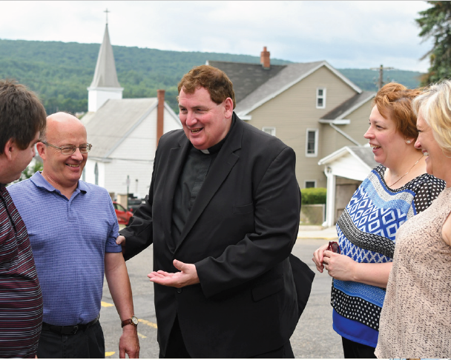
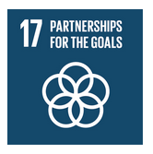
Founding Partnership
The Mother Maria Kaupas Center serves as the anchor partnership for the Coal Region Field Station facilitating projects and community connections in the Mount Carmel area.

Slide 5
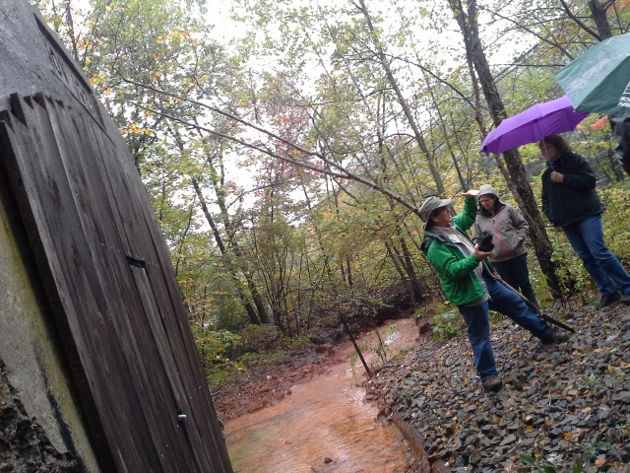
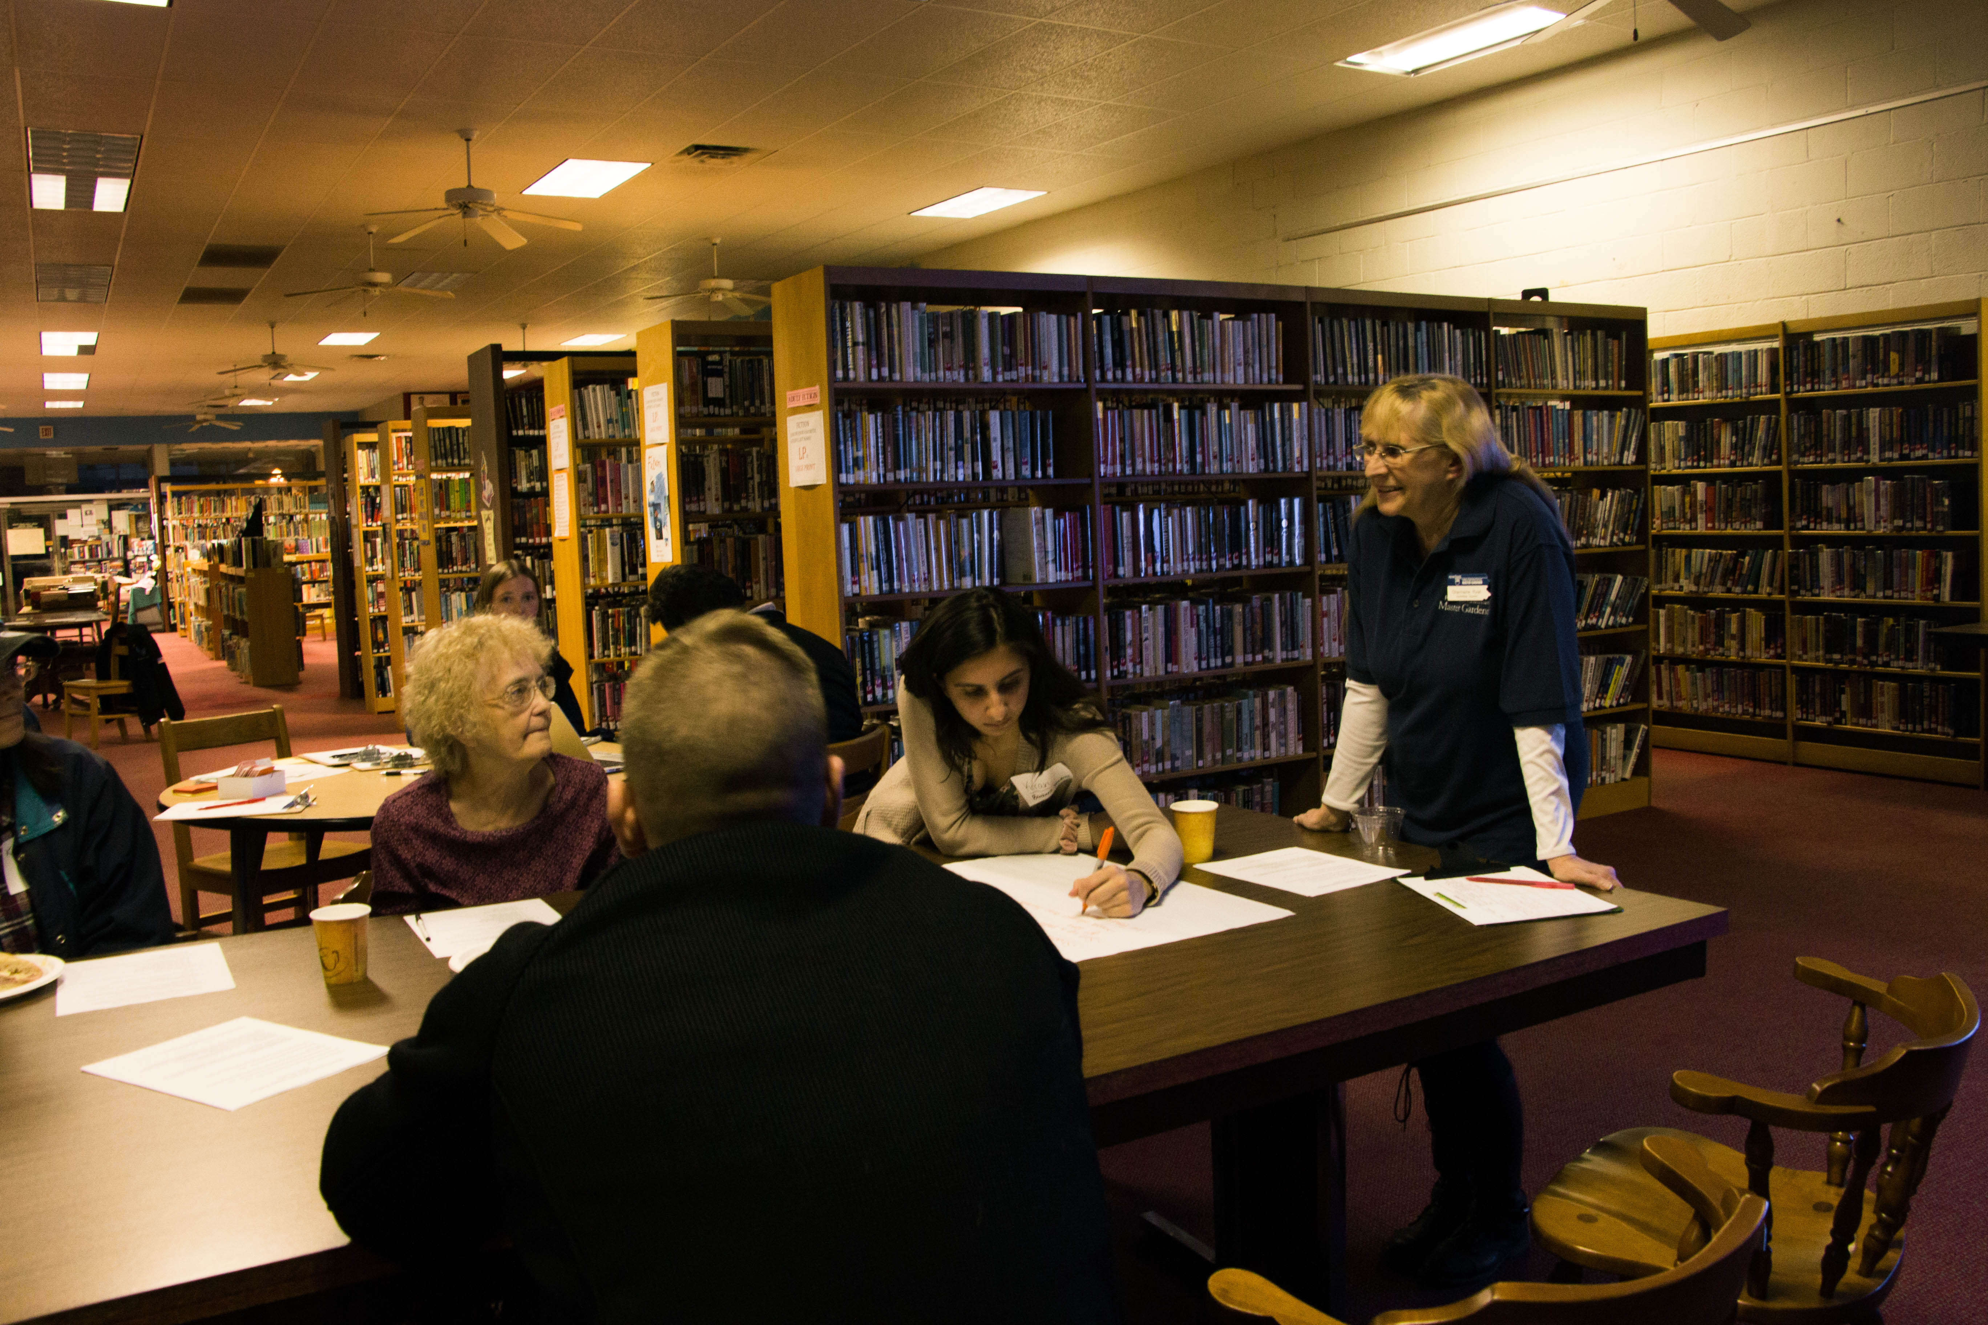
Variety of Engagement
Community-based research and service learning through coursework
Faculty and staff led research
Student research, summer and academic year
Student internships
Volunteering
Objective: “chain” projects for increased utility and impact. Chaining can occur across varieties of engagement.

Slide 6
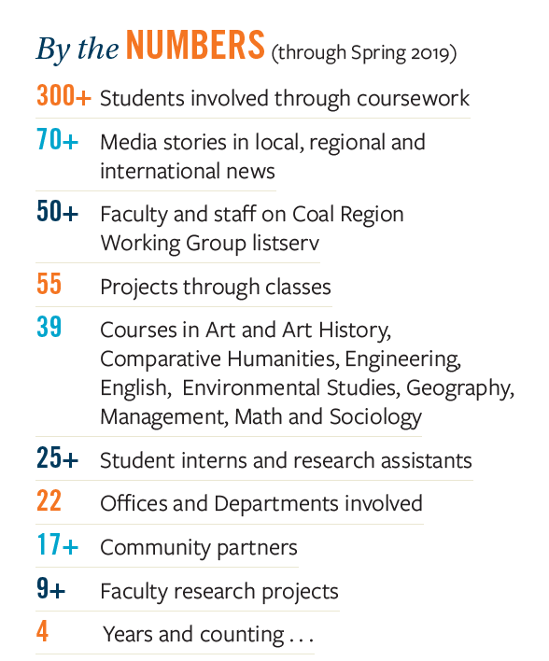

Slide 7
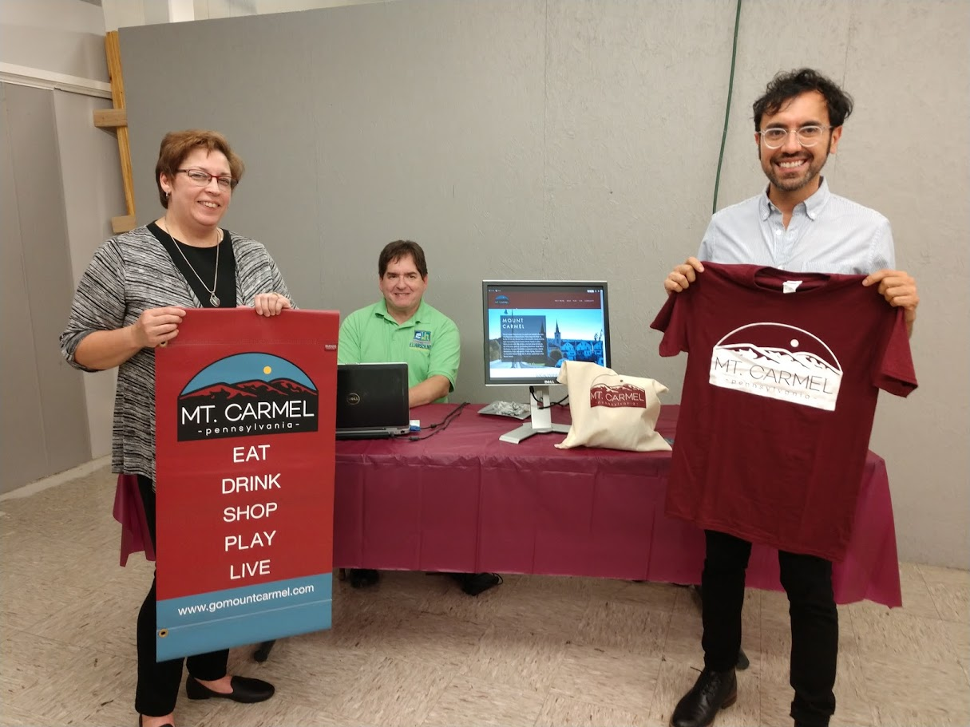
Coal Region Field Station: Project Examples
Economic development strategies
Organizational strategic planning
Cultural heritage studies
Green space development
Renewable energy installation potential
Improving food pantry operations
Reviving high school greenhouse
Planning and expanding community garden
Church architecture analysis
Visual identity and web development for downtown development group
Creating themed downtown walking paths connected to local shopping reward program.

Slide 8
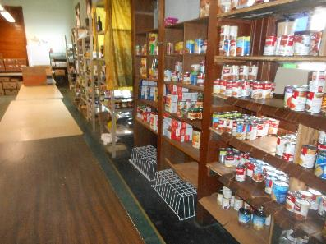
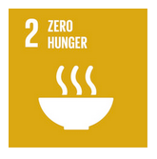
MOUNT CARMEL AREA FOOD PANTRY
MANAGEMENT 101 – Spring 2017

Slide 9
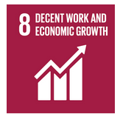
MOUNT CARMEL DOWNTOWN INC. Rebranding project – Management & graphics design

Slide 10
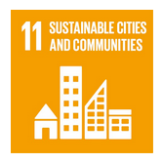
RECREATION / SWIMMING POOL
MSUS 400 – Project chained over 3 academic years (2016-2018)

Slide 11
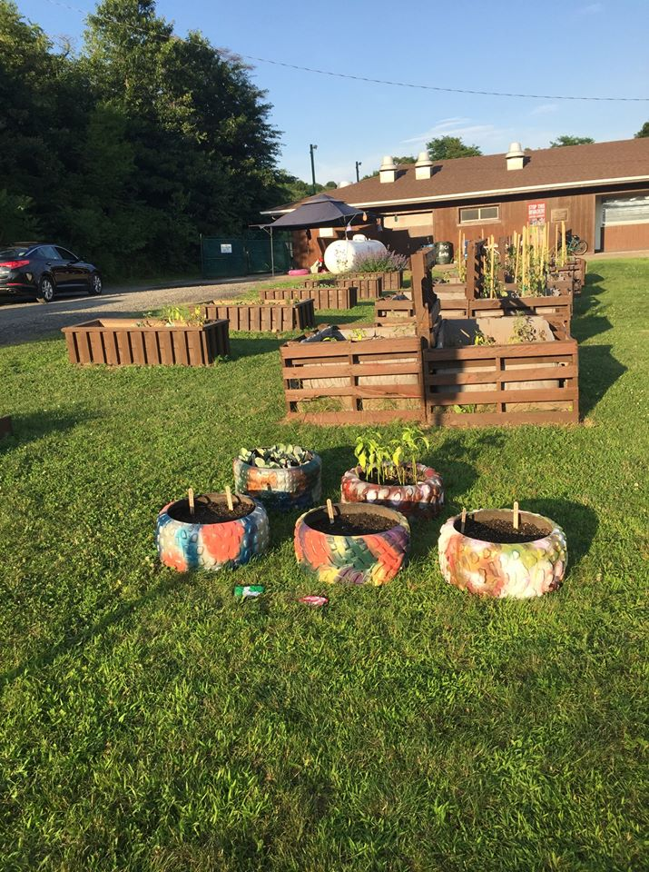
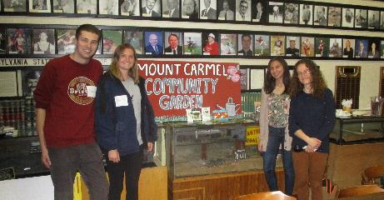
COMMUNITY GARDEN
ENST 411 – 2017, 2019; Growing Change VISTA

Slide 12
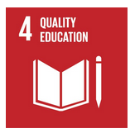
PUBLIC LIBRARY SUSTAINABILITY MSUS 400 (Spring 2019)

Slide 13
MMKC STRATEGIC PLAN MSUS 400

Slide 14
From Class to Volunteering to Internship: Developing a Summer Camp
Kaupas Camp now entering its 4th summer!!
CLASS
SPRING 2016
VOLUNTEERING
SUMMER 2016
INTERNSHIP
SUMMER 2016
Students in MSUS 400 worked with the Kaupas Summer Camp Task Force on planning for the inaugural 5-8th grade athletic and academics summer camp as part of their project on Strategic Planning with the Kaupas Center.
Bucknell coaches and student-athletes volunteer at summer camp
Student intern assesses summer camp and offers suggestions to Task Force for future camps
Notes:
The Quality Education SDG includes efforts to improve education, access to education, engender life long learning, and improve/expose students to sustainability and environment topics.

Slide 15
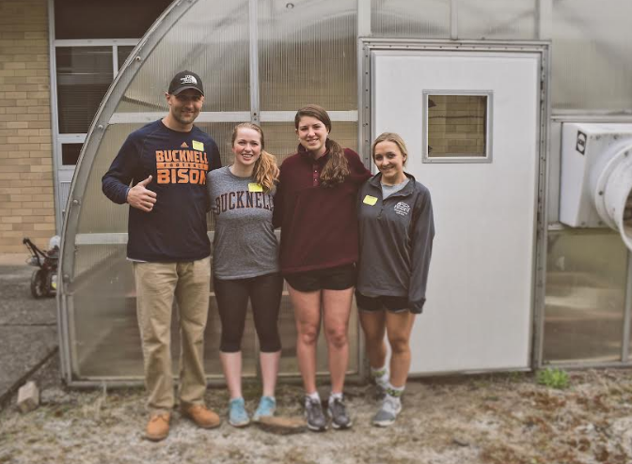
Building Local Food Resiliency
Projects ranging from . . .
Food pantry collaboration
Food pantry operations
Food access
High School Greenhouse
Community garden
Notes:
The Zero Hunger SDG is about ending hunger and ensuring access to nutritious and sufficient food. As we know, the US suffers from food security with an estimated 1 in 8 being food insecure.
Food pantry – MGMT 101; athletics donations; prisoners’ group donations
High school greenhouse – ENST 411, ILST summer
Community garden – feasibility study and guide

Slide 16
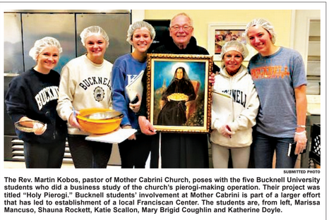
Cultural Heritage
Research and projects that capture oral histories and cultural practices
Notes:
The Sustainable Cities and Communities SDG calls for increases in and access to green space, preserving cultural and natural heritage, safe adequate and affordable housing, regional planning, public transportation – these are all concerns for communities with whom we partner in the lower anthracite region. We have began projects in a few of these areas, and other projects that fall within these areas of concern are being discussed.

Slide 17
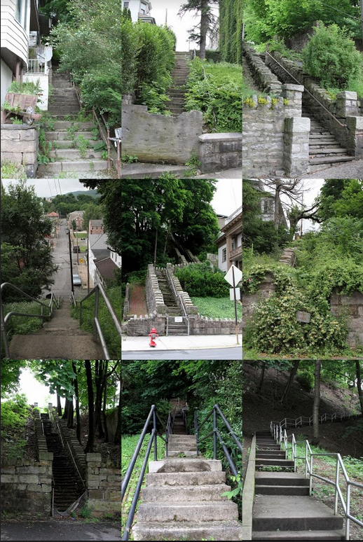
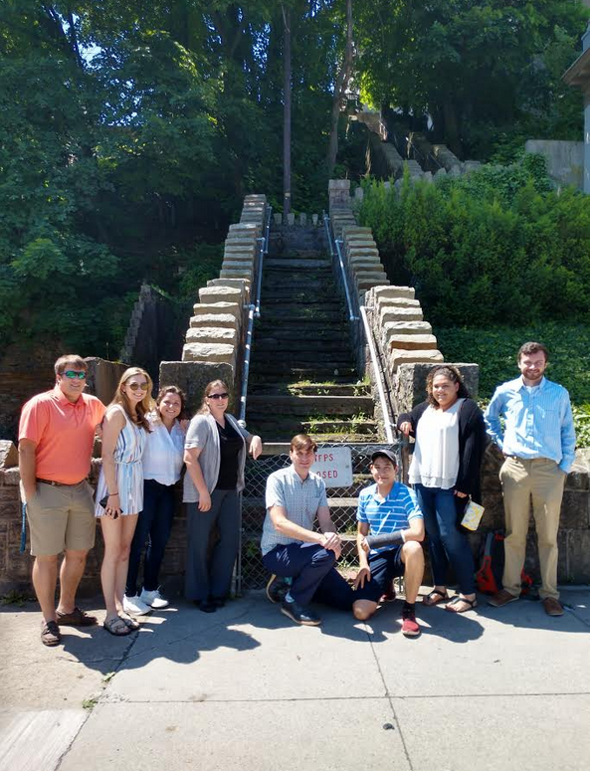
Walkable Communities
Summer 2019 Exploring Sustainable Communities class project – Supporting grant application to restore public steps
Notes:
The Sustainable Cities and Communities SDG calls for increases in and access to green space, preserving cultural and natural heritage, safe adequate and affordable housing, regional planning, public transportation – these are all concerns for communities with whom we partner in the lower anthracite region. We have began projects in a few of these areas, and other projects that fall within these areas of concern are being discussed.

Slide 18
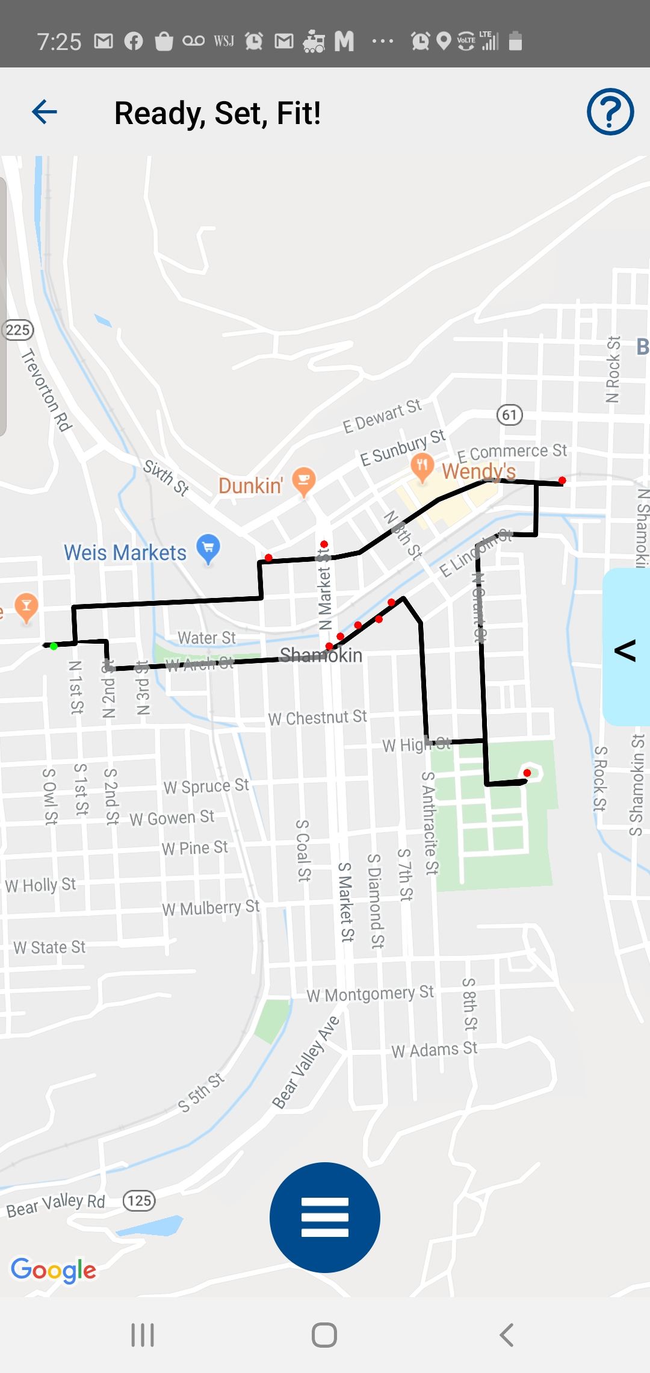
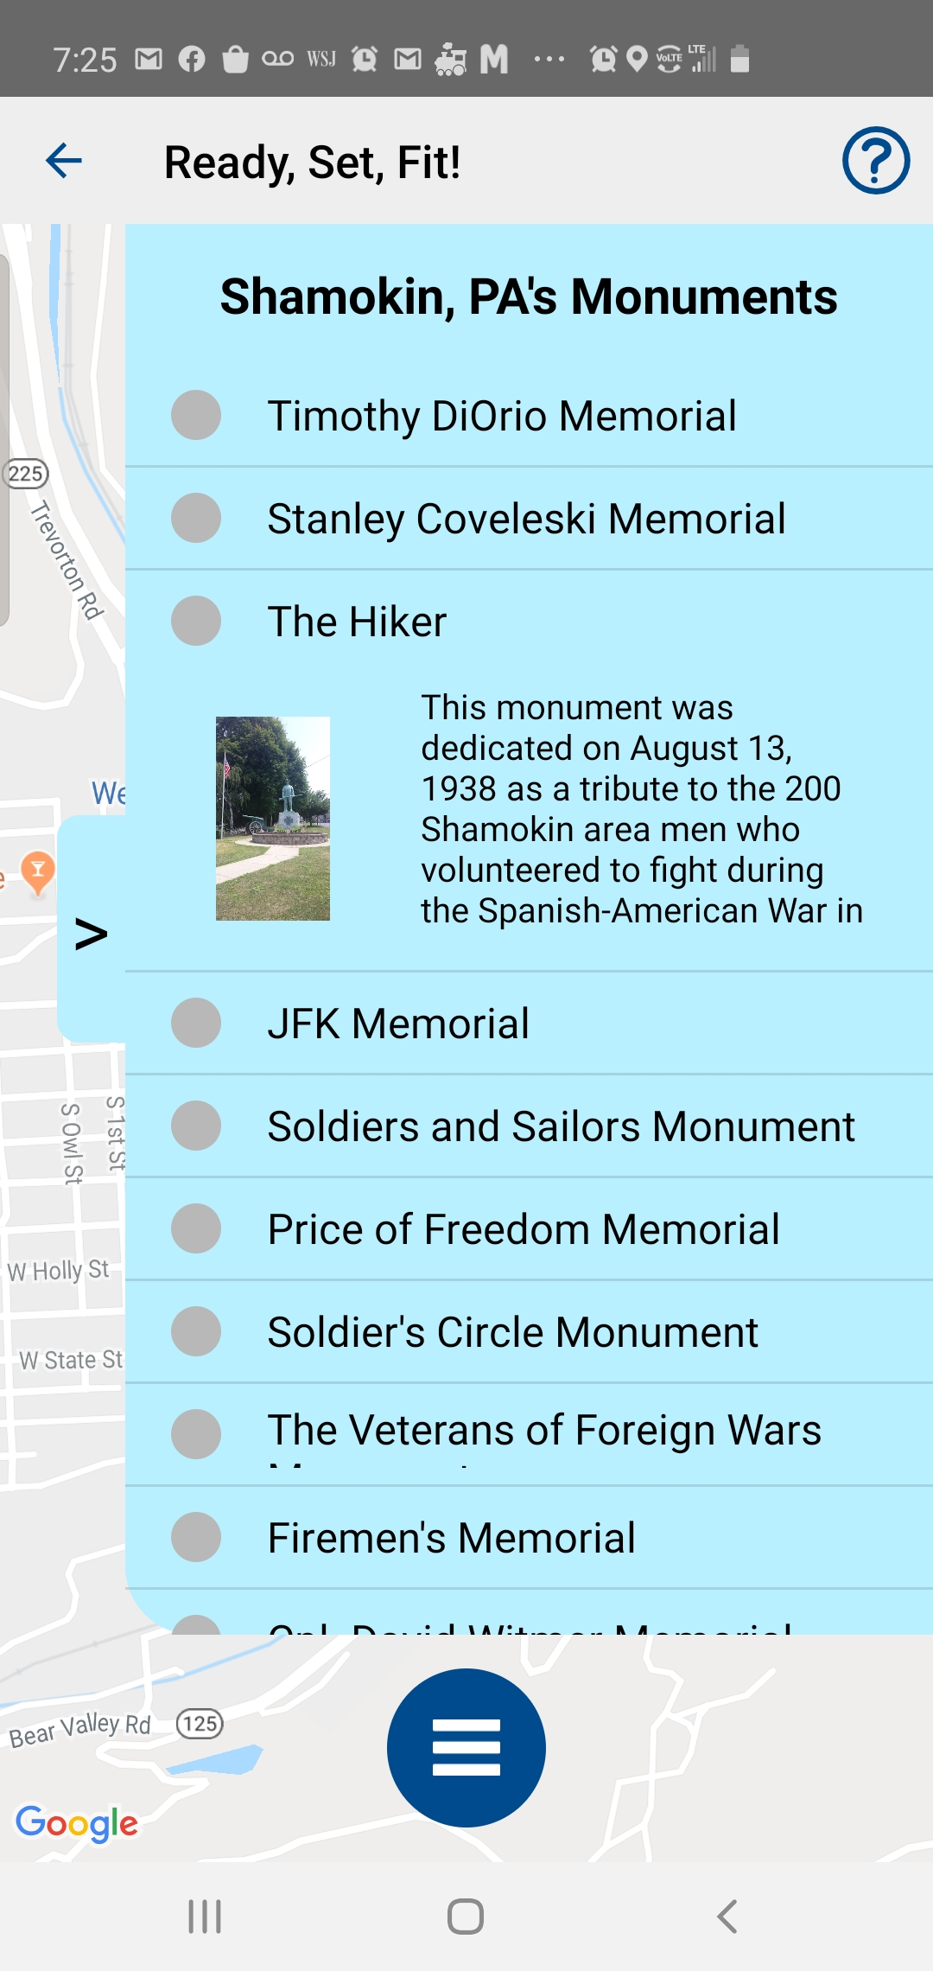
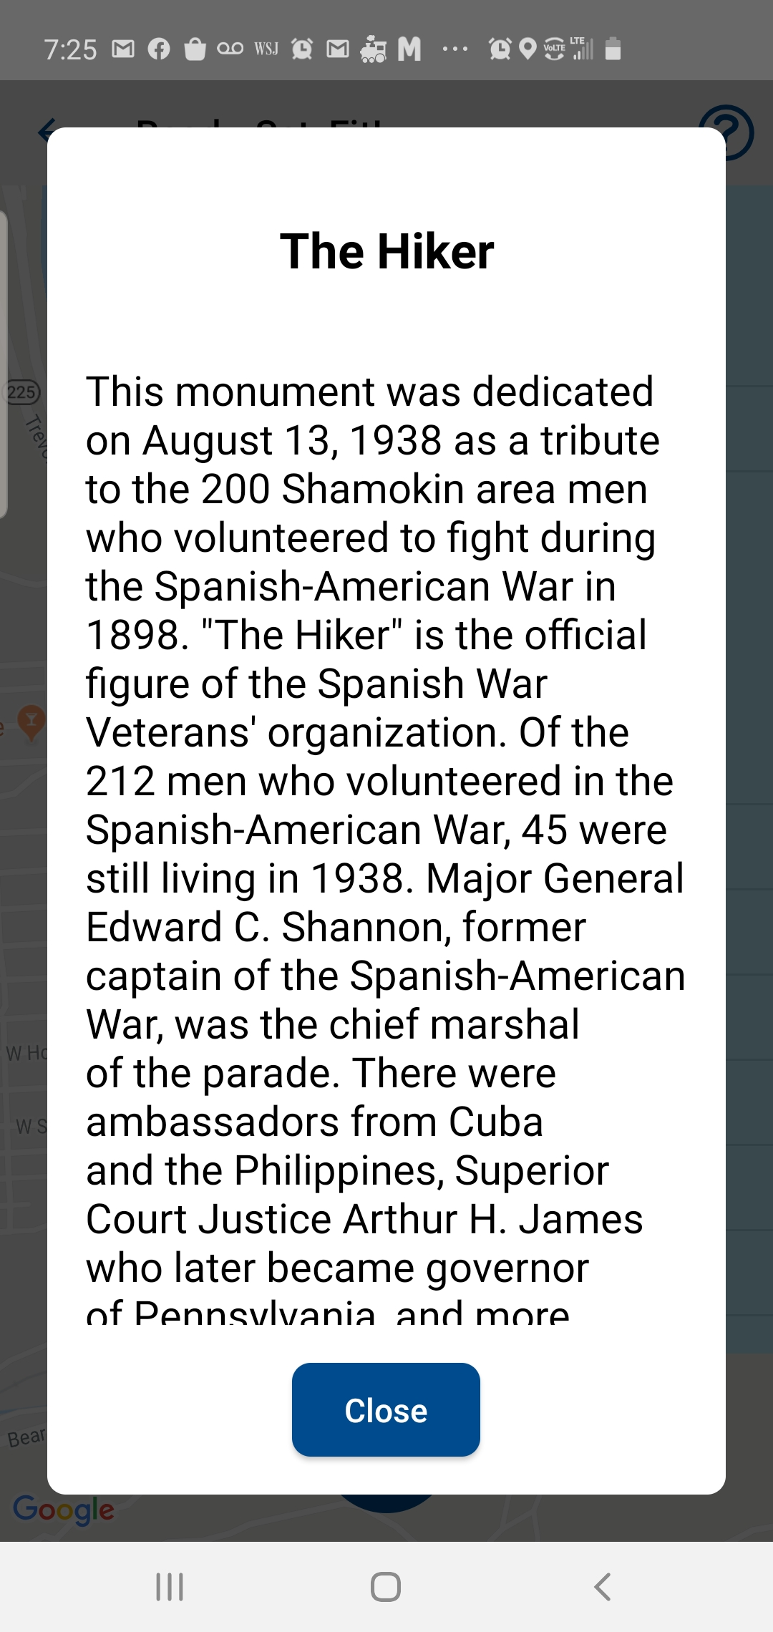
Ready, Set, Fit (RSF) – A Health and Wellness App
A themed walking path app developed by Bucknell faculty and students as an interdisciplinary collaborative.
30+ themed paths including in lower anthracite coal region communities
Community partners can write content and develop paths
https://readysetfitapp.org/

Slide 19
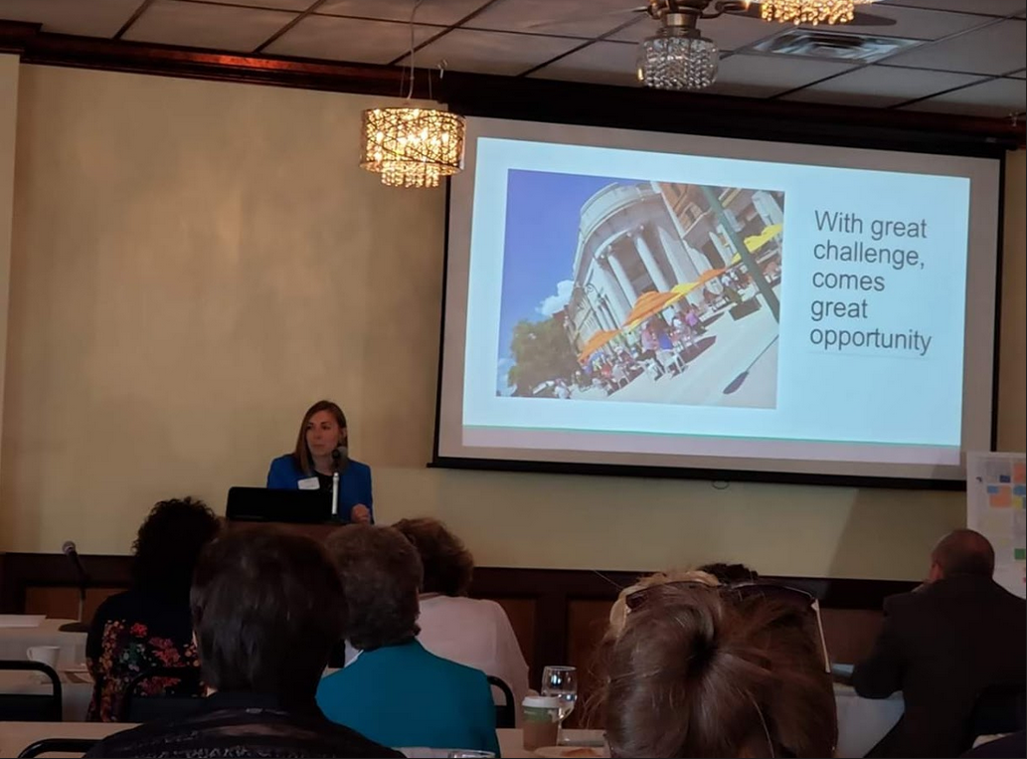
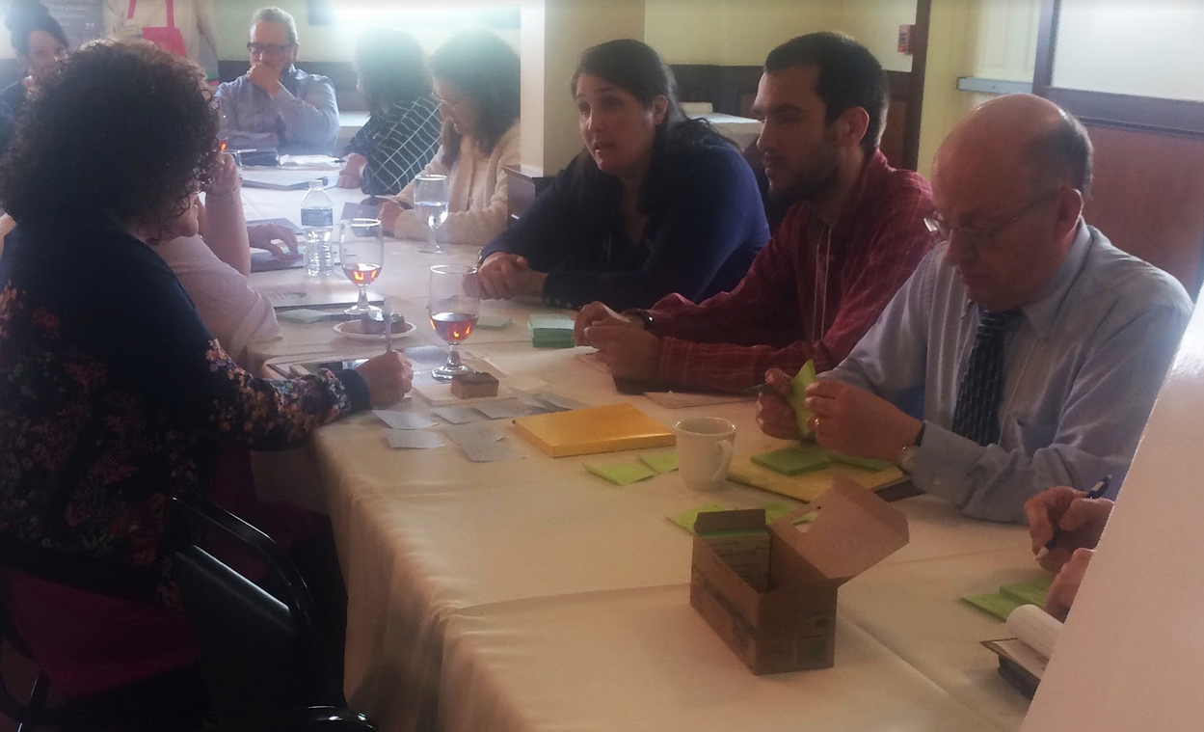
Economic Revitalization Convening, May 2019
Convening in Shamokin with over 70 attendees from business, non-profits, faith communities, financial sector, universities and local, state, and federal government.
Through SWOT analysis, developed goals and action items to further local economic revitalization.
Partnership between Bucknell Univ, Bloomsburg Univ., Susquehanna Univ, Greater Susquehanna Valley Chamber of Commerce, Anthracite Region for Progress, Mother Maria Kaupas Center, Shamokin Area Businesses for Economic Revitalization, and City of Shamokin

Slide 20
AND MANY MORE:
Fighting blight
Celebrating heritage
Development of walking trail
Study of church architecture
Addiction
Opioid crisis
Historic walk – app and fitness
After-school program
Food security
School greenhouse revitalization
Middle School summer camp
INSTITUTE FOR SUSTAINABLE TECHNOLOGY – solar energy studies and food pantry summer projects
FACILITATE IMPORTANT CONTACTS:
SCI Coal Township
United Way

Slide 21
“A conservative coal town and one of America’s most respected liberal arts universities may seem far apart on many levels, but the Bucknell-Mount Carmel relationship is proving that, as the world gets smaller, we can all learn from each other, and grow with each other.” – Editorial from The News-Item
Contact: Jake Betz
Executive Director
Mother Maria Kaupas Center
kaupascenterdrc@ptd.net
Contact: Shaunna Barnhart, PhD
Director, Place Studies program
Center for Sustainability and Environment
sb060@bucknell.edu

