Slide 1
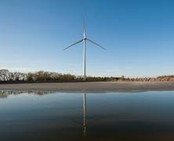
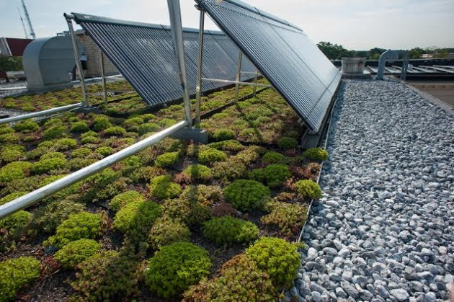
Renewable Energy Trends In Higher Education
PERC
October 24, 2016

Slide 2
Background
Important factors shaping renewable energy in higher ed:
The higher ed sector is committed to mitigating GHGs
Wind & solar costs have plummeted, making renewables financially attractive compared to conventional energy
Federal tax credits have been supporting growth
Net metering and renewable portfolio standards with solar carve outs have enabled growth in onsite solar in some states
States with deregulated wholesale and retail choice allow colleges and universities to source offsite renewables, while regulated states inhibit this strategy

Slide 3
Green Power In Higher Ed
Bullet points

Slide 4
Green Power In Higher Ed by Type
Bullet points

Slide 5
Avg Green Power per Campus

Slide 6
Avg Green Power per Campus by Type

Slide 7
Campuses Buying Green Power

Slide 8
Campuses Buying Green Power by Type
Bullet points

Slide 9
Gross Emissions Per Campus
Notes:
From PCC dataset only. Average

Slide 10
Avg GHG Reductions from Renewables per Campus
Notes:
From PCC dataset only. Average

Slide 11
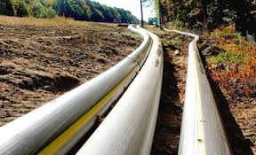
Case Study: University of New Hampshire
Goal: 50% reduction by 2020, CN by 2050
Energy GHGs 2009: 57,158 MTCO2e
Energy GHGs 2015: 48,139 MTCO2e (24,893 MTCO2e)
Renewables 2016: <1% attributable (37% un-attributable)
Net Cost/Savings:
Renewables 2016 | Cost/Savings | GHGs MTCO2e | Energy
EcoLine (landfill gas) | $49 million, 10 yr payback | 0 (18,405) | 379,583 MMBTU/yr
Onsite solar thermal | 50% | 27.5 | 367 MMBTU/yr
Offsite micro-hydro | $200,000 (20%)/yr | 0 (4,250) | 6,524/MWh/yr
Key Takeaways:
Co-gen has been an essential GHG and efficiency strategy but limits future options
Tension between pride that “we don’t buy RECs, we sell them” and desire to tout renewables use
- Serious co-benefits to small, local micro-hydro

Slide 12
Case Study: American University
Goal: Climate neutral by 2020
Energy GHGs 2009: 45,000 MTCO2e
Energy GHGs 2015: 0 MTCO2e
Renewables 2016: 100%
Net Cost/Savings: ~$1M savings/year
Renewables 2016 | Cost/Savings/yr | GHGs MTCO2e | Energy MWh/yr
RECs | $20k | 20,000 | 20,000
Onsite solar PV | ~$0 | 0 | 1,500
Onsite solar thermal | 35% savings | 0 | 1,750
Offsite solar PV | ~$1M | 30,000 | 30,000
Key Takeaways:
- RECs are low cost and convenient
- Onsite solar is visible but small scale & no GHG benefit claimed due to SREC value
- Offsite solar was large scale & financially attractive

Slide 13
Key Takeaways
The number of colleges and universities buying renewable energy grew 2,000% between 2006 and 2015¹.
Renewable energy purchases in higher ed grew more than 30 fold from 2006 to 2015¹, increasing from 100,000 MWh to 3.286 million MWh.
RECs are the main way of sourcing renewables but are declining in popularity and total volume.
Onsite solar is increasingly common but produces a small amount of energy.
Offsite renewables purchases are twice as large as any other renewable source, on average.

Slide 14
Acknowledgements
Produced by the UNH Sustainability Institute and Altenex
Authors
Jennifer Andrews, Project Director, Sustainability Institute, University of New Hampshire
Dovev Levine, Ph.D., Assistant Dean, UNH Graduate School
Chris O’Brien, Director of Higher Education Programs, Altenex; Faculty, Kogod School of Business, American University
Data Partners

Slide 15
Methodology Notes
Data sources included:
US EPA Green Power Partnership reports
ACUPCC reports
AASHE STARS reports
CarbonMap greenhouse gas reports
Renewable energy reporting is voluntary and most campuses do not report.
REC ownership is required for any source to be considered green power. But this report uses the term “RECs” to describe sourcing strategies that include “unbundled RECs,” as well as RECs bundled with energy by retail energy suppliers or utilities. See www.greengigawatt.org for more information.
Data for 2015 is considered incomplete.
Annual reporting periods varied among the data sources. Data was assigned to the calendar year during which the majority of the reported data occurred.
Where data was reported to more than one source, the sources were selected in the following order: US EPA GPP, ACUPCC, AASHE STARS, CarbonMap.

