Slide 1
PA Colleges Food Recovery Challenge
A partnership driven by Sodexo, PERC and the EPA

Slide 2
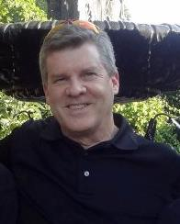
Speaking
Josh Hooper
Executive Director
Pennsylvania Environmental Resource Consortium (PERC)

Slide 3
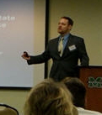
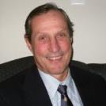
Speaking Today
Josh Hooper
PERC
Luke Wolfgang
U.S. EPA
Tom O’Donnell
U.S. EPA
Brittany Prischak
Mercyhurst University
Craig Dalen
Messiah College

Slide 4
PA Colleges Food Recovery Challenge
Agenda
Planned Agenda for the Call
PERC and the PHE-FRC -Josh Hooper, PERC
EPA and the PHE-FRC -Luke Wolfgang, EPA -Tom O’Donnell, EPA
1st joiner: Mercyhurst University -Brittany Prischak
2nd-to-join Messiah College –Craig Dalen
FRC online software -Luke Wolfgang, EPA
PHE-FRC -making it work -Josh Hooper & group
Question and Answers -Group
Next meeting scheduling -Group
A partnership driven by Sodexo, PERC and the EPA

Slide 5
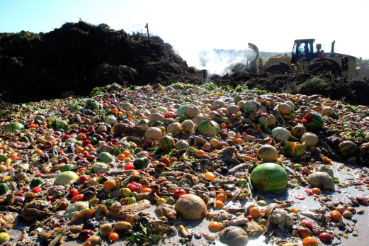
The Problem
2010:
35 million tons of food waste
97%

Slide 6
The Problem
14% of U.S. households are food insecure
1 in 5 kids

Slide 7
The Problem
Wasted food= wasted money

Slide 8
The Problem
Decomposing food generates methane; a potent greenhouse gas
33 times
more potent
than CO²
^{Shindell, et al, Science, 2009}

Slide 9
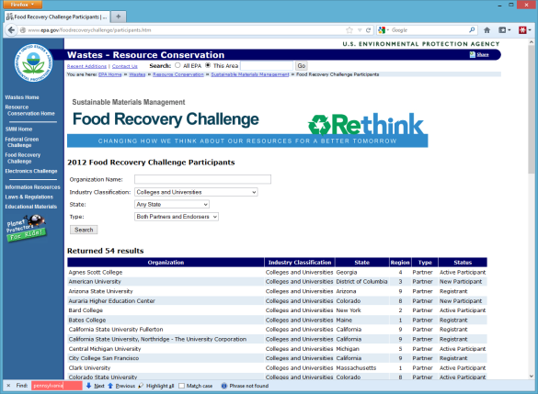
EPA

Slide 10
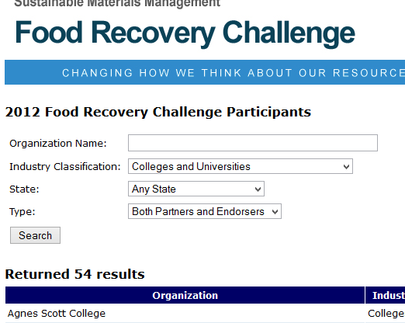
EPA

Slide 11
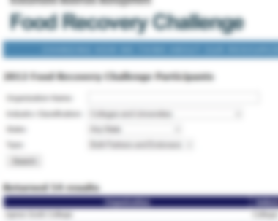
EPA

Slide 12
Partnership
With the support of Sodexo, PERC has joined U.S. EPA as a WasteWise program partner. Part of WasteWise is food recovery.

Slide 13
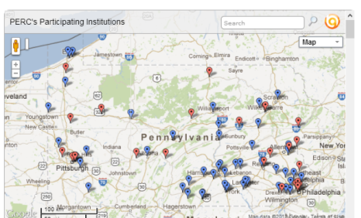
Statewide Collaboration
By tackling food recovery as a statewide challenge, PA schools will benefit from friendly competition and collective momentum.

Slide 14
Sharing Success
Regular communications to Pennsylvania's colleges and universities sharing challenges met and success stories.

Slide 15
Secretariat
PERC will track PHE-FRC metrics reported by participating institutions and recognize progress made along a variety of parameters.

Slide 16
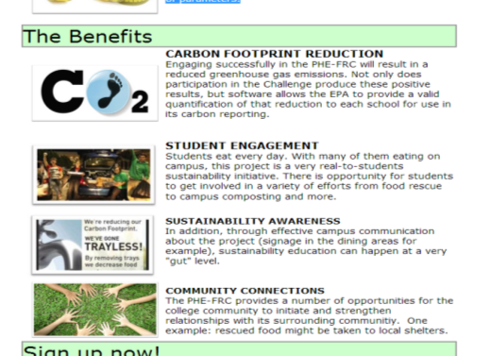
Benefits

Slide 17
Taking the Challenge

Slide 18
Committed Schools
Mercyhurst University
Erie, PA
Messiah College
Mechanicsburg, PA
Shippensburg University of PA
Shippensburg, PA
Penn State Erie *
Erie, PA

Slide 19
PA Colleges Food Recovery Challenge
Agenda
Planned Agenda for the Call
PERC and the PHE-FRC -Josh Hooper, PERC
EPA and the PHE-FRC -Luke Wolfgang, EPA -Tom O’Donnell, EPA
1st joiner: Mercyhurst University -Brittany Prischak
2nd-to-join Messiah College –Craig Dalen
FRC online software -Luke Wolfgang, EPA
PHE-FRC -making it work -Josh Hooper & group
Question and Answers -Group
Next meeting scheduling -Group
A partnership driven by Sodexo, PERC and the EPA

Slide 20
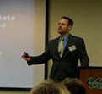
Speaking
Luke Wolfgang
Sustainability Coordinator
Office of Materials Management
US EPA Region III
Tom O’Donnell
Sustainability Partnership
US EPA Region III

Slide 21
PA Colleges Food Recovery Challenge
Agenda
Planned Agenda for the Call
PERC and the PHE-FRC -Josh Hooper, PERC
EPA and the PHE-FRC -Luke Wolfgang, EPA -Tom O’Donnell, EPA
1st joiner: Mercyhurst University -Brittany Prischak
2nd-to-join Messiah College –Craig Dalen
FRC online software -Luke Wolfgang, EPA
PHE-FRC -making it work -Josh Hooper & group
Question and Answers -Group
Next meeting scheduling -Group
A partnership driven by Sodexo, PERC and the EPA

Slide 22
Speaking
Brittany Prischak
Sustainability Officer
Mercyhurst University
Erie, PA

Slide 23
PA Colleges Food Recovery Challenge
Agenda
Planned Agenda for the Call
PERC and the PHE-FRC -Josh Hooper, PERC
EPA and the PHE-FRC -Luke Wolfgang, EPA -Tom O’Donnell, EPA
1st joiner: Mercyhurst University -Brittany Prischak
2nd-to-join Messiah College –Craig Dalen
FRC online software -Luke Wolfgang, EPA
PHE-FRC -making it work -Josh Hooper & group
Question and Answers -Group
Next meeting scheduling -Group
A partnership driven by Sodexo, PERC and the EPA

Slide 24
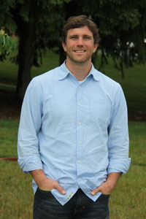
Speaking
Craig Dalen
Sustainability Coordinator
Messiah College
Mechanicsburg, PA

Slide 25
PA Colleges Food Recovery Challenge
Agenda
Planned Agenda for the Call
PERC and the PHE-FRC -Josh Hooper, PERC
EPA and the PHE-FRC -Luke Wolfgang, EPA -Tom O’Donnell, EPA
1st joiner: Mercyhurst University -Brittany Prischak
2nd-to-join Messiah College –Craig Dalen
FRC online software -Luke Wolfgang, EPA
PHE-FRC -making it work -Josh Hooper & group
Question and Answers -Group
Next meeting scheduling -Group
A partnership driven by Sodexo, PERC and the EPA

Slide 26
A glimpse at the software
Luke Wolfgang
Sustainability Coordinator
Office of Materials Management
US EPA Region III

Slide 27
PA Colleges Food Recovery Challenge
Agenda
Planned Agenda for the Call
PERC and the PHE-FRC -Josh Hooper, PERC
EPA and the PHE-FRC -Luke Wolfgang, EPA -Tom O’Donnell, EPA
1st joiner: Mercyhurst University -Brittany Prischak
2nd-to-join Messiah College –Craig Dalen
FRC online software -Luke Wolfgang, EPA
PHE-FRC -making it work -Josh Hooper & group
Question and Answers -Group
Next meeting scheduling -Group
A partnership driven by Sodexo, PERC and the EPA

Slide 28
Making it work
Monthly call (w/ video)
Data: monthly (after b-line) -expected
Paragraph report: monthly Challenge/ Success reports: featured
EPA technical-support
Guest speakers on most of calls
PERC: overall data-monthly report
Working Team Officers: Chair, Secretary
Publish: Website? Forum? Social media?
Josh Hooper
Executive Director
Pennsylvania Environmental Resource Consortium (PERC)

Slide 29
PA Colleges Food Recovery Challenge
Agenda
Planned Agenda for the Call
PERC and the PHE-FRC -Josh Hooper, PERC
EPA and the PHE-FRC -Luke Wolfgang, EPA -Tom O’Donnell, EPA
1st joiner: Mercyhurst University -Brittany Prischak
2nd-to-join Messiah College –Craig Dalen
FRC online software -Luke Wolfgang, EPA
PHE-FRC -making it work -Josh Hooper & group
Question and Answers -Group
Next meeting scheduling -Group
A partnership driven by Sodexo, PERC and the EPA

Slide 30
Question and Answer
Josh Hooper
PERC
Luke Wolfgang
U.S. EPA
Tom O’Donnell
U.S. EPA
Brittany Prischak
Mercyhurst University
Craig Dalen
Messiah College

Slide 31
PA Colleges Food Recovery Challenge
Agenda
Planned Agenda for the Call
PERC and the PHE-FRC -Josh Hooper, PERC
EPA and the PHE-FRC -Luke Wolfgang, EPA -Tom O’Donnell, EPA
1st joiner: Mercyhurst University -Brittany Prischak
2nd-to-join Messiah College –Craig Dalen
FRC online software -Luke Wolfgang, EPA
PHE-FRC -making it work -Josh Hooper & group
Question and Answers -Group
Next meeting scheduling -Group
A partnership driven by Sodexo, PERC and the EPA

Slide 32
Sign up!

Slide 33
Sign up!

Slide 34
Sign up!

Slide 35
Next Call
Now?
Doodle?
Other
Josh Hooper
Executive Director
Pennsylvania Environmental Resource Consortium (PERC)

Slide 36
IMPACT
Make an

Slide 37
PA Colleges Food Recovery Challenge
Thanks for joining!
A partnership driven by Sodexo, PERC and the EPA

