Slide 1
Campus Energy Efficiency Fund PERC Fall Conference and Annual Meeting Climate Change Panel Joyce Ferris October 29, 2013

Slide 2
WHO WE ARE
Experienced investors in the energy efficiency and sustainability sector.
Developers of energy efficiency and sustainability projects.
Shifting from investing in technologies to project and service businesses.
Strong team with investment and operating experience in the sector.
2

Slide 3
CAMPUS ENERGY EFFICIENCY FUND OVERVIEW
Over $45 million of capital for energy efficiency, sustainability, and on-site generation projects for Pennsylvania colleges and universities
Pennsylvania Treasury Department is the lead investor
CEEF led investment underway
$7.5 million of projects with Drexel University and Montgomery County Community College in 2013
$10 million target for 2014

Slide 4
ENERGY AND CLIMATE IMPACT TO DATE
Drexel University
35% energy and carbon reduction across 5 buildings
44% energy reduction in science building lab space
energy savings funding important upgrades and maintenance
health and safety, comfort and reliability benefits too
Montgomery County Community College
74% energy savings and carbon reduction for outdoor lights on two campuses
69% net savings due to adding new fixtures
aesthetic, maintenance and safety benefits too

Slide 5
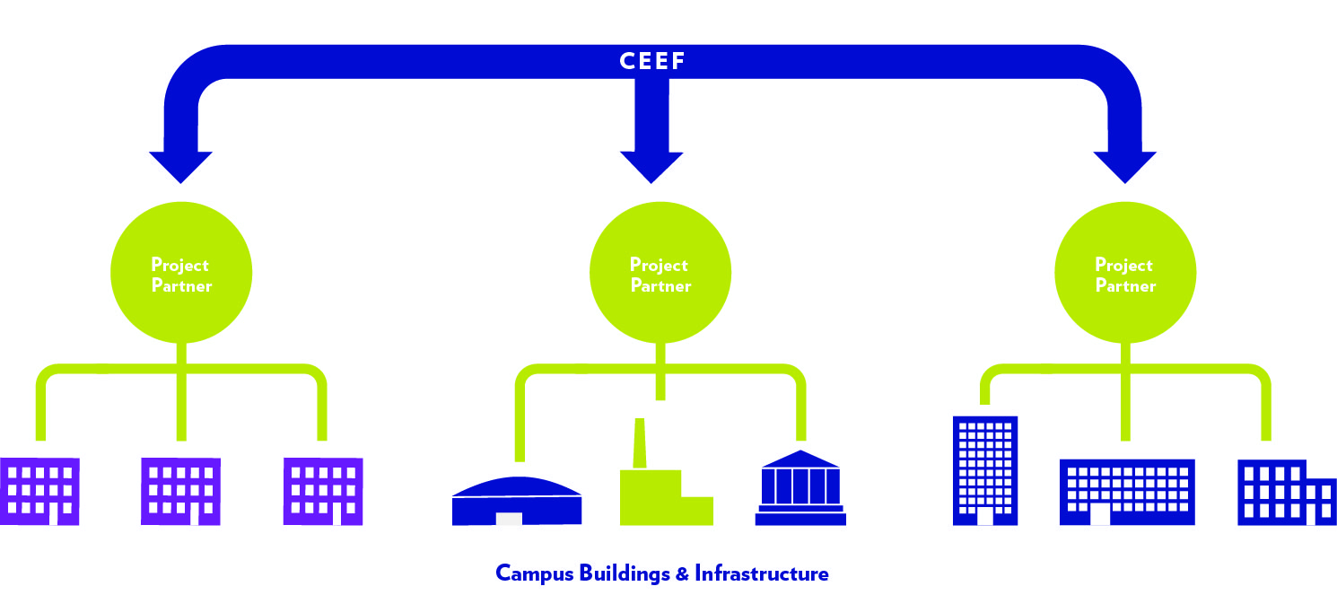
INVESTING IN ENERGY EFFICIENCY AND
SUSTAINABILITY PROJECTS

Slide 6
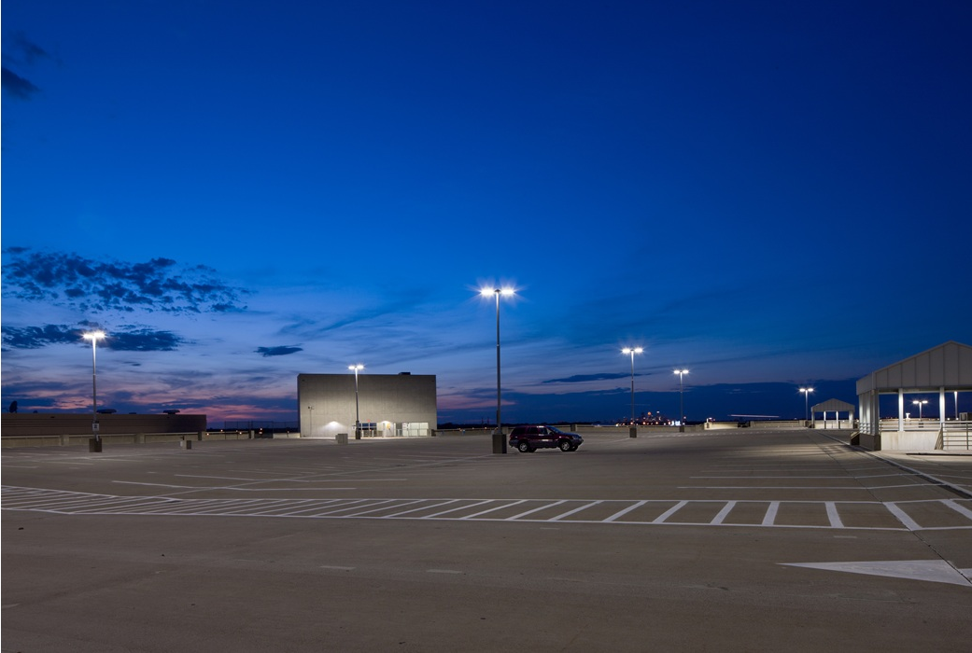
OUR GOAL IS TO TRANSFORM THE
BUSINESS OF PROVIDING ENERGY
EFFICIENCY AND SUSTAINABILITY SERVICES

Slide 7
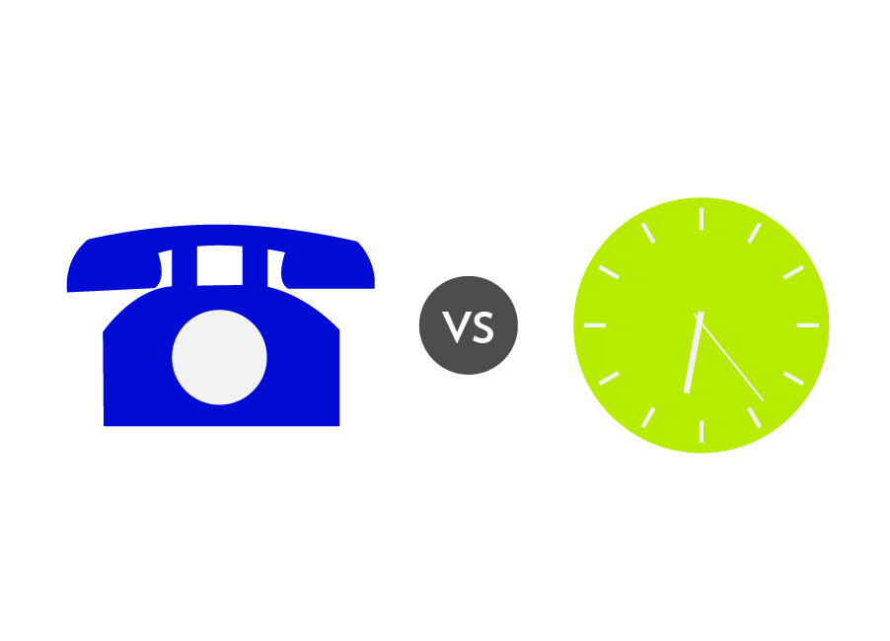
PROPERTY OWNERS WANT SOLUTIONS,
NOT EQUIPMENT
Power Purchase Agreement transitioned the solar industry to selling electricity not solar panels
Charging by the minute transformed the telecom industry to selling communication, not cell phones

Slide 8
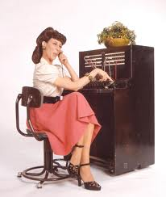
TIME FOR NEW BUSINESS MODELS
VS
We have 2013 technologies…
…deployed using 1960’s business models.

Slide 9
FUNDING STRUCTURE -
EFFICIENCY SERVICE AGREEMENT (ESA)
Efficiency “as-a-service” - ESA payments are based on achieved energy savings from the installed efficiency measures.
Risk allocation - Through the ESA structure, Blue Hill and CEEF take the risk of achieving energy savings. If projects don’t save energy we don’t make a return.
Modular but deep solutions - Science building retrofits, outdoor lighting retrofits, retro-commissioning, and water efficiency
Comprehensive but incremental approach- multi-year strategy to achieve energy and sustainability transformation Value beyond energy savings- health and safety, public relations, occupant comfort…..

Slide 10
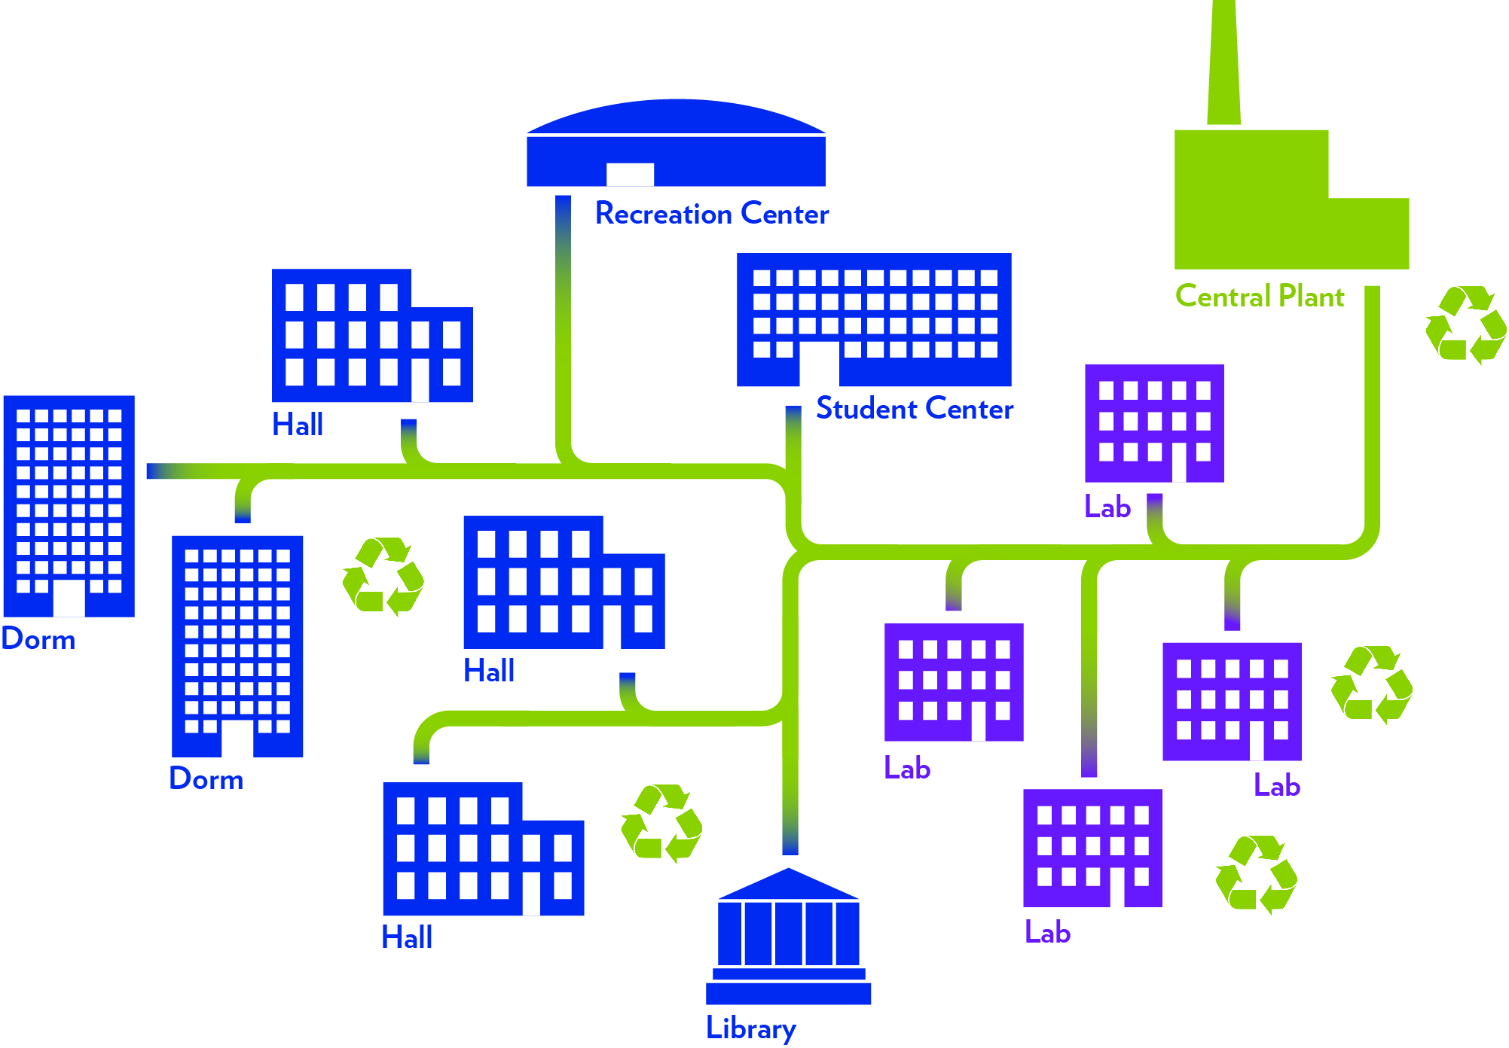
A CUSTOMIZED APPROACH

Slide 11
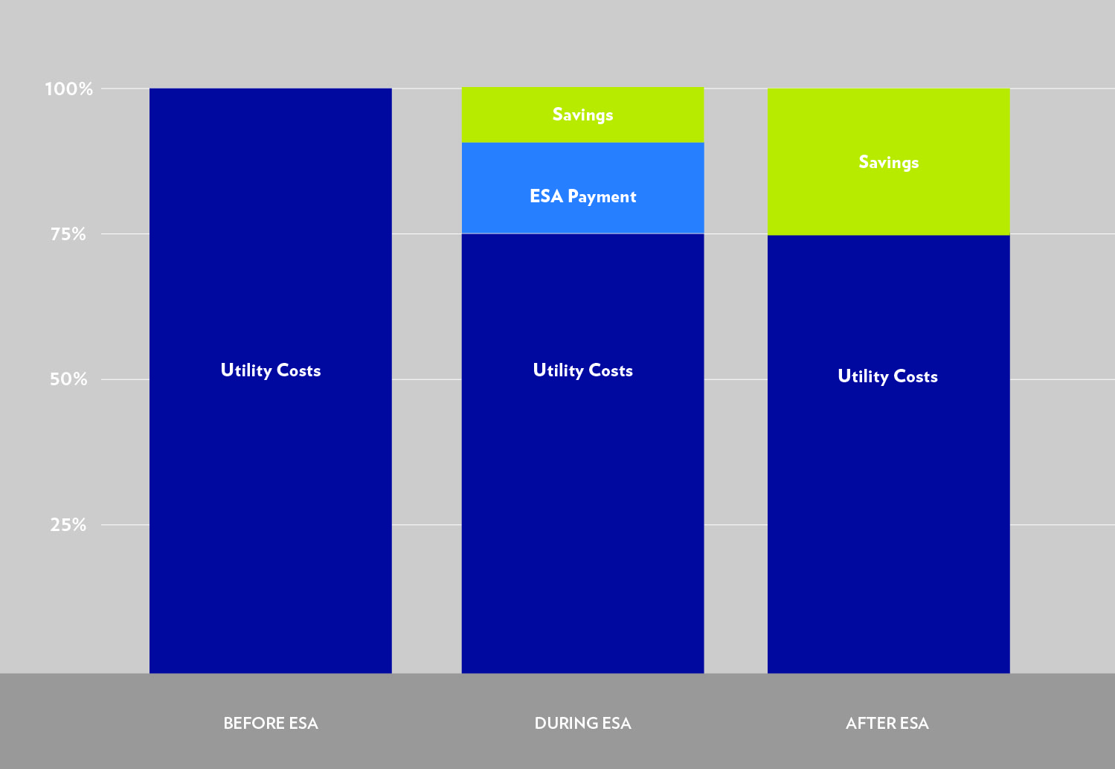
ENERGY SERVICES AGREEMENT
PAYMENT STRUCTURE

Slide 12
DREXEL PROJECT HIGHLIGHTS
Science Building Retrofits
controls upgrade of 3 science buildings
centralized demand control ventilation
46% energy reduction for lab space
Complete Mechanical Upgrade of a Research Center
100,000 sq ft Paul Peck Research Center
some energy savings, dramatic comfort and reliability benefits
Supplemental Energy Efficiency Investment for a Building Renovation
CEEF funding stretched the budget to maximize energy efficiency in the renovation

Slide 13
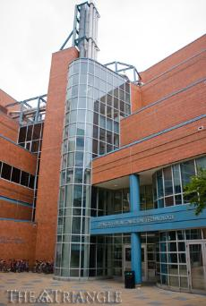
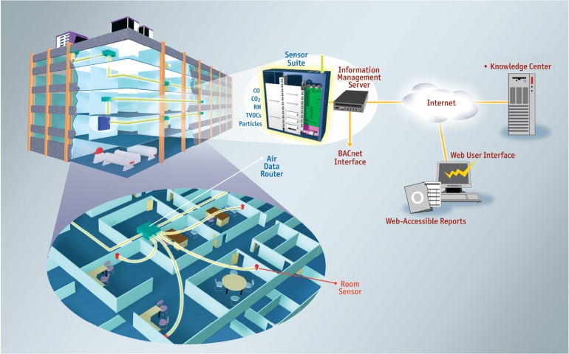
DREXEL UNIVERSITY
SCIENCE BUILDING RETROFIT
Controls upgrade of three science building labs
state of the art lab controls for three buildings totaling over 62 lab spaces
energy savings of over 46%
additional Environment, Health and Safety benefits
Drexel Science and Engineering Pod
Aircuity DCV Infrastructure

Slide 14
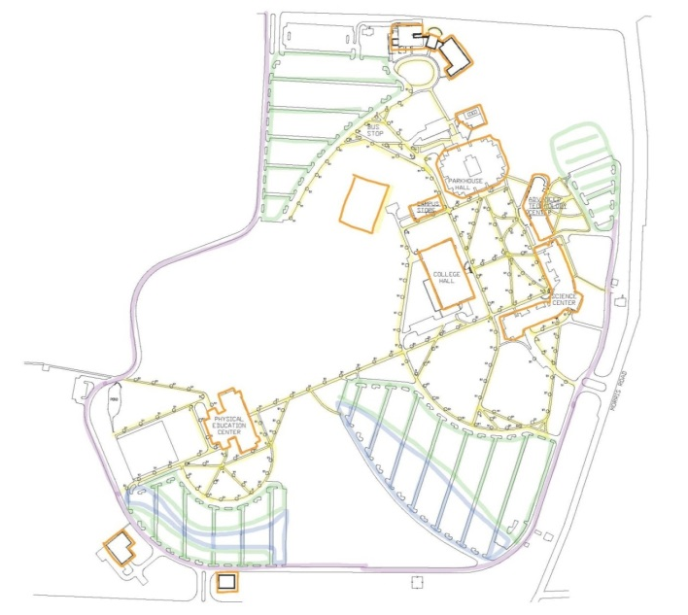
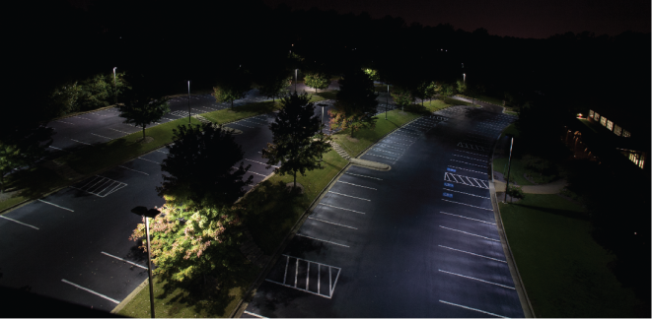
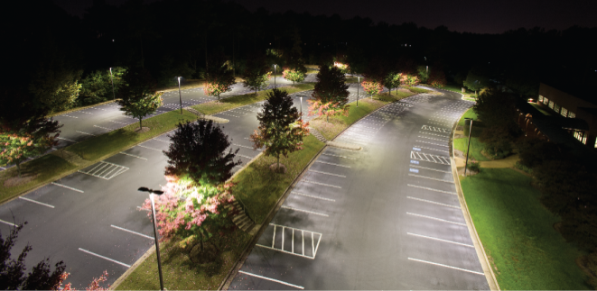
Zone 1 | wallpacks
Zone 2 | walkways
Zone 3 | parking
Zone 4 | Parking
Zone 5 | loop road
MONTGOMERY COUNTY COMMUNITY
COLLEGE LIGHTING RETROFIT
retrofit over 600 outdoor and parking garage lighting fixtures, on the school’s two campuses
outdated lighting technology will be replaced with high efficiency LED fixtures and a full suite of wireless and IP enabled lighting controls
structured as an Energy Services Agreement (ESA), with Blue Hill paid for energy savings delivered to the customer over a 10 year contract
over duration of the contract Blue Hill will ensure equipment maintenance and replacement
Central Campus Lighting Map
Before
After

Slide 15
Blue Hill Partners 40 West Evergreen Avenue Philadelphia, PA 19118 www.bluehillpartners.com Joyce Ferris Managing Partner 215-248-5244

